Slide 1
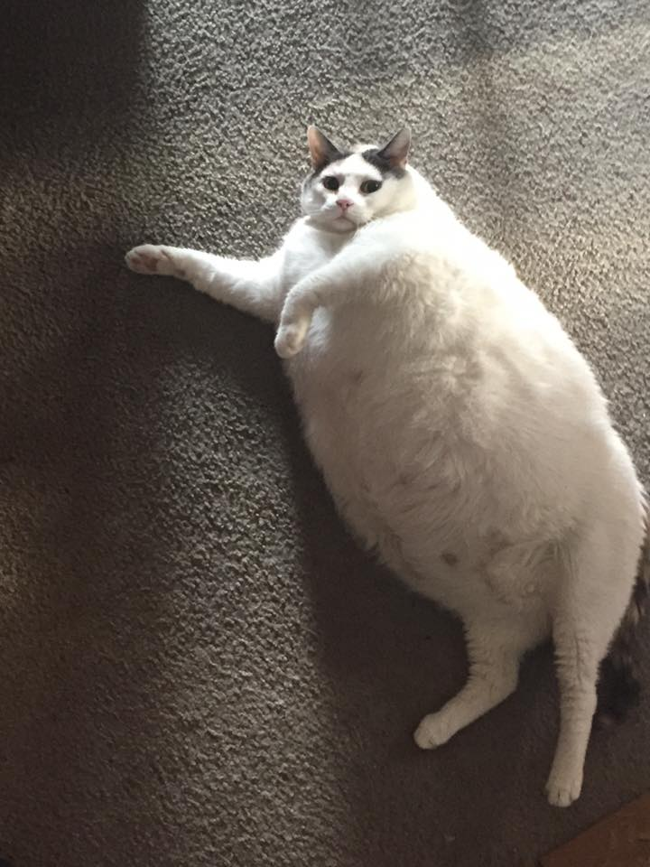
Today’s lesson
Gravitational force and fields
I’m not Fat !
I am a very attractive cat!
Feel my gravitational PULL!
You cant argue with Physics!

Slide 2
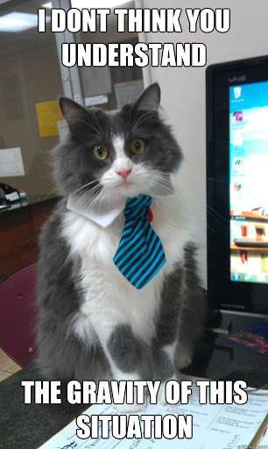
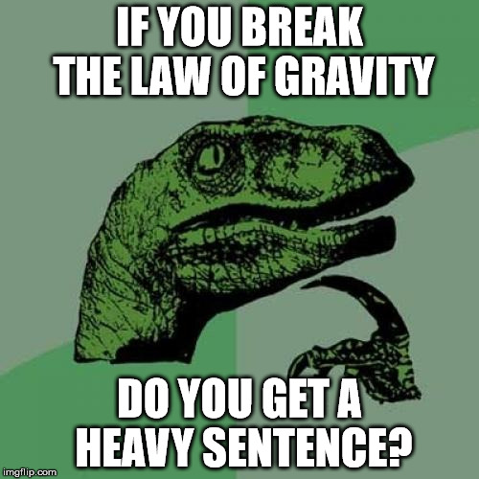
Gravity
What is gravity?
Notes:
Ask them!

Slide 3
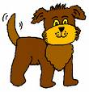
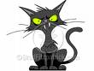
Newton’s Explanation of Gravity
Gravity is a force between ALL objects!
Gravity

Slide 4
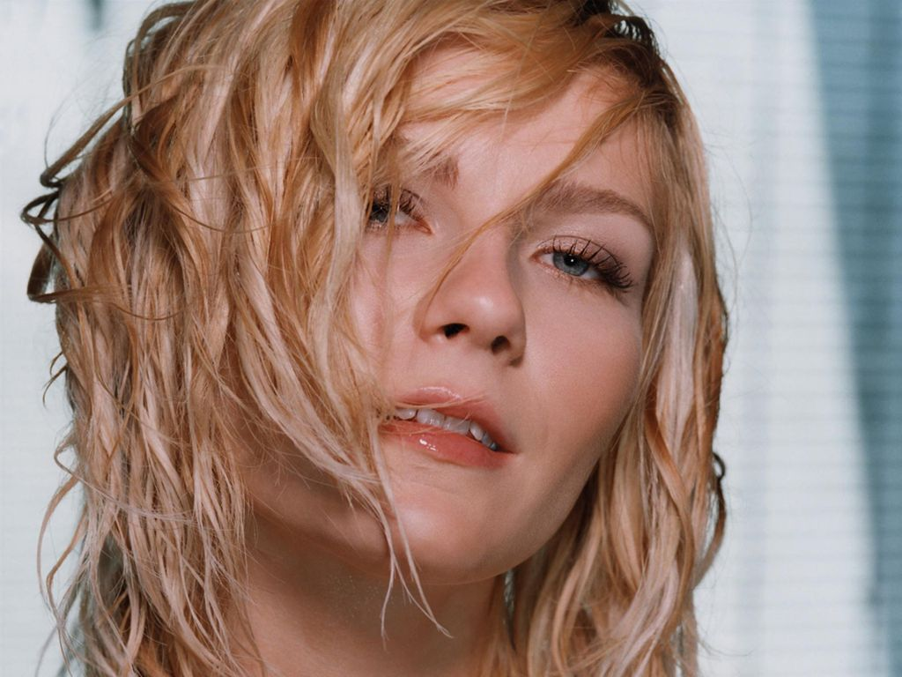
Gravitational Force and Field
We already know that;

Slide 5
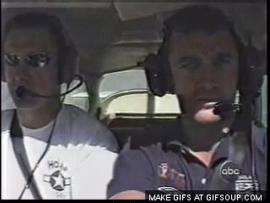
This is how NASA do it!

Slide 6
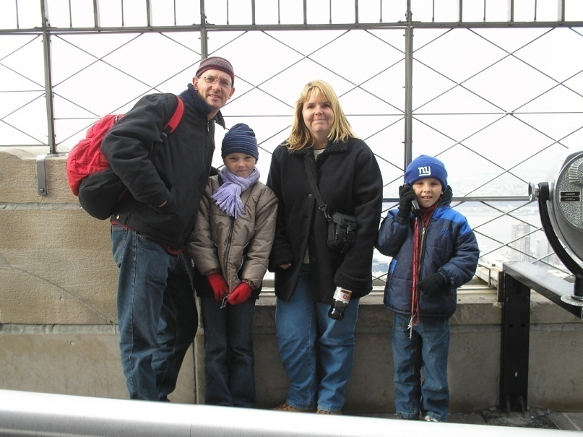
Gravity
Gravity is a very weak force.
The force of gravitational attraction between This man and his wife (when 1 metre apart) is only around 0.0000004 Newtons!

Slide 7
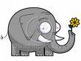
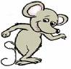
Gravity
The size of the force depends on the mass of the objects. The bigger they are, the bigger the force!
Small attractive force
Bigger attractive force

Slide 8
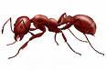
Gravity
The size of the force also depends on the distance between the objects.

Slide 9
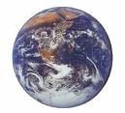
Gravity
We only really notice the gravitational attraction to big objects!
Hola! ¿Como estas?

Slide 10
Gravity
The force of gravity has a special name. Do you know what it is?
George?

Slide 11
Gravity
The force of gravity on something is called its weight. Because it is a force it is measured in Newtons.
Weight

Slide 12
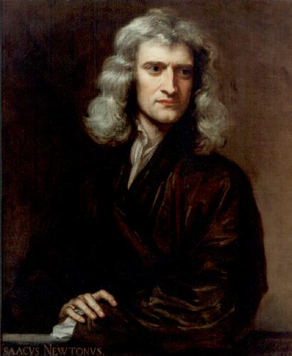
Newton’s law of Gravitation
The force between masses was formulated (discovered?) by Isaac Newton in 1687

Slide 13
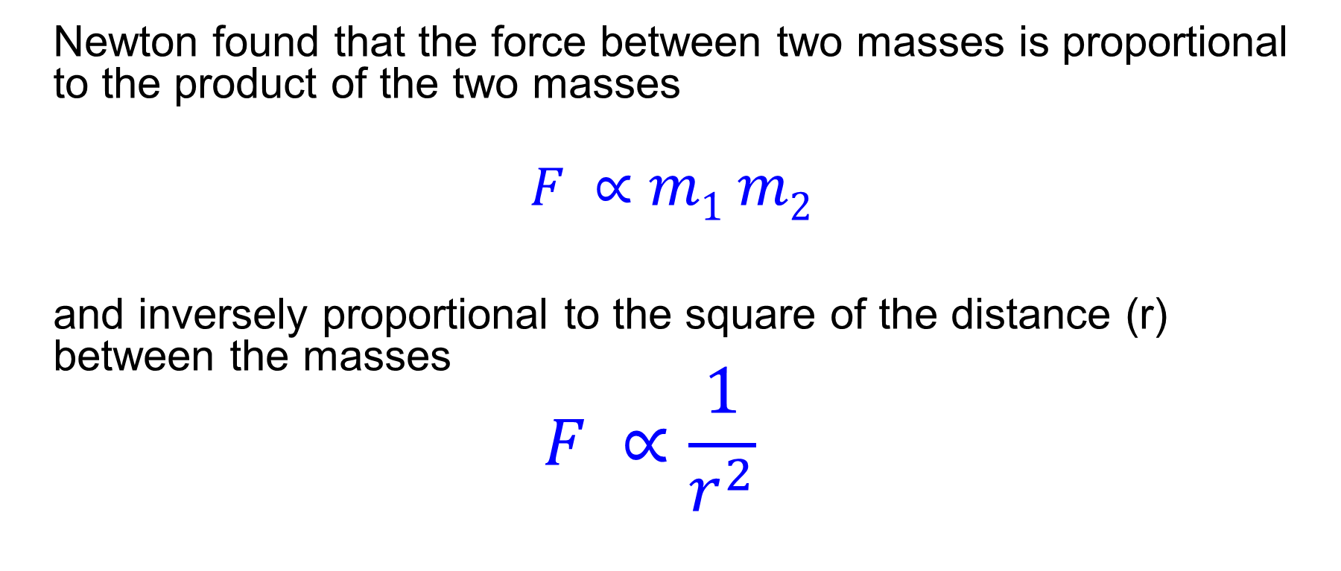
Gravitational Force and Field
Newton found that the force between two masses is proportional to the product of the two masses
$$F ∝m1 m2$$
and inversely proportional to the square of the distance (r) between the masses
$$F ∝\frac{1}{r^{2}}$$

Slide 14
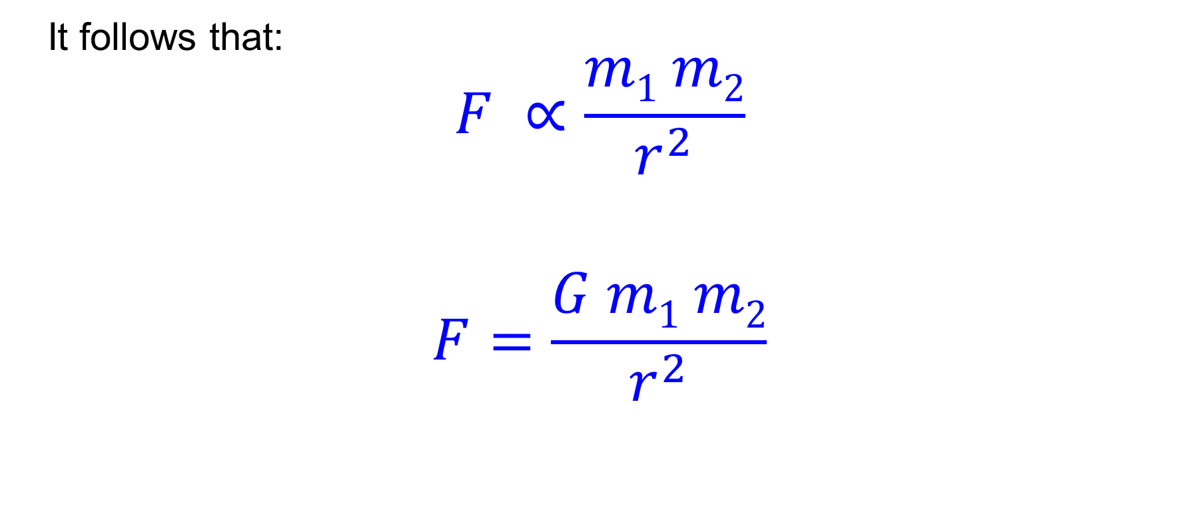
Newton’s law of universal gravitation
It follows that:
$$F ∝\frac{m1 m2}{r^{2}}$$
$$F=\frac{G m1 m2}{r^{2}}$$

Slide 15
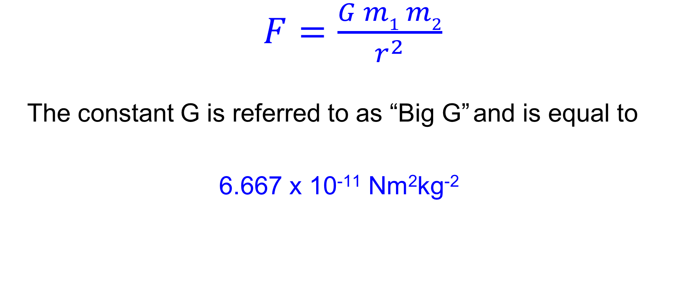
Newton’s law of universal gravitation
$F=\frac{G m1 m2}{r^{2}}$
The constant G is referred to as “Big G” and is equal to
6.667 x 10⁻¹¹ Nm²kg⁻²

Slide 16
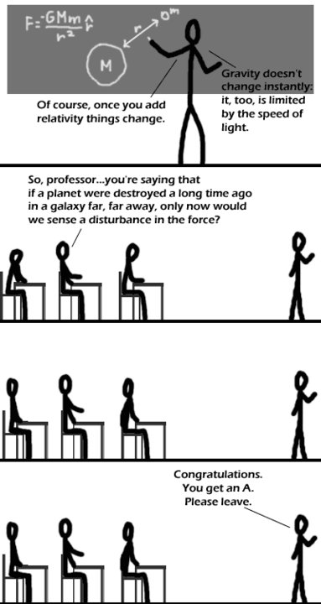

Slide 17
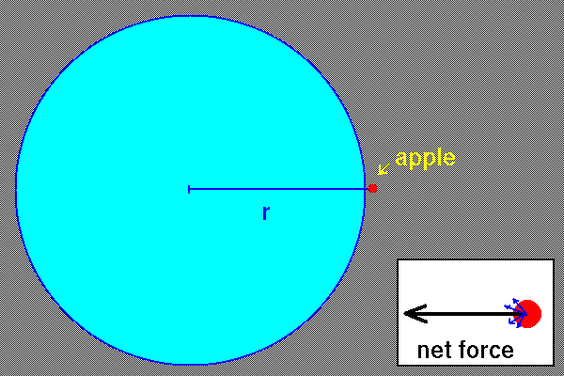
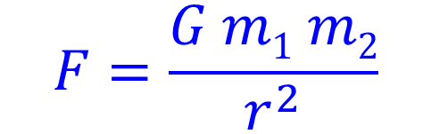
Applies to point masses
$$F=\frac{G m1 m2}{r^{2}}$$
For large objects like the earth, r is the distance to the centre of mass

Slide 18
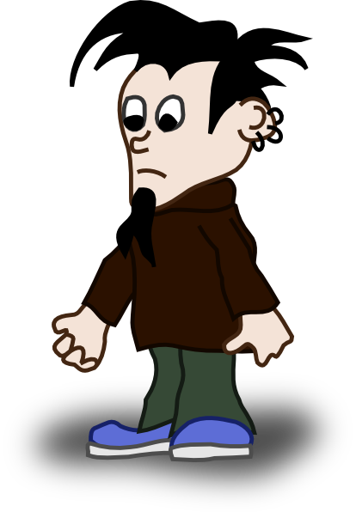
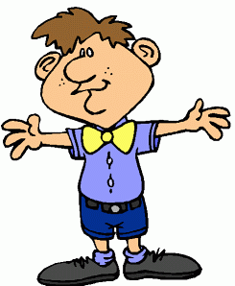
Calculations using Newton’s law
What is the force of attraction between Louis and Tadashi?
2 m
63kg ?
70kg ?

Slide 19
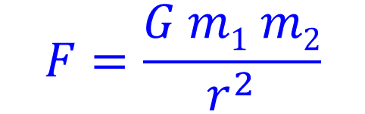
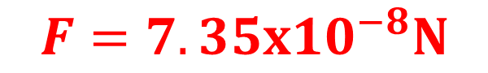
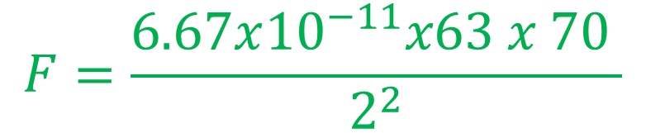
Calculations using Newton’s law
$$F=\frac{G m1 m2}{r^{2}}$$
$$F=\frac{6.67x{10}^{−11}x63 x 70 }{2^{2}}$$
$$F=7.35x{10}^{−8}N$$
2 m
63kg ?
70kg ?

Slide 20
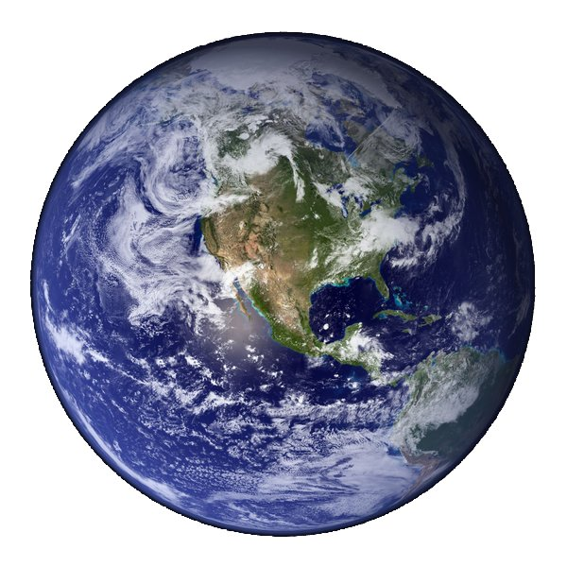

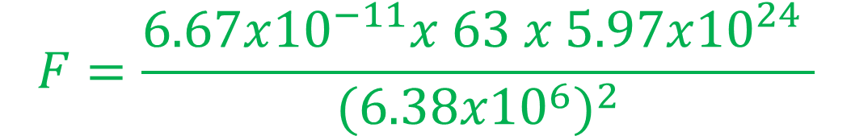

Force of gravity due to earth on Louis?
What is the force of attraction between Louis and the Earth?
$$F=\frac{G m1 m2}{r^{2}}$$
$$F=\frac{6.67x{10}^{−11}x 63 x 5.97x{10}^{24} }{{(6.38x{10}^{6})}^{2}}$$
63kg ?
r = 6.38 x10⁶ m, m = 5.97 x 10²⁴ kg
$$F=616 N$$

Slide 21
Gravitational field
An area or region where a mass feels a gravitational force is called a gravitational field.
The gravitational field strength at any point in space is defined as the force per unit mass (on a small test mass) at that point.
g = F/m (in N.kg⁻¹)

Slide 22

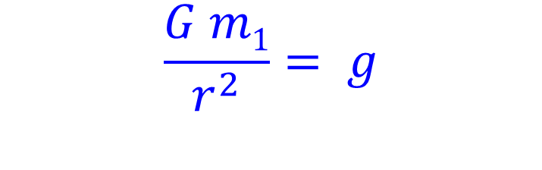
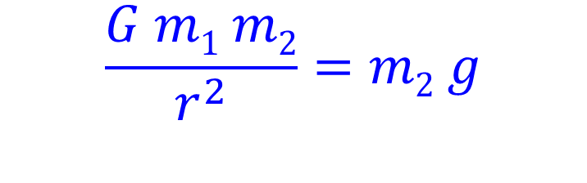

Gravitational field around a point mass
If we have two masses m₁ and m₂ distance r apart
Looking at the weight force on m₂ due to m₁,
$$F=\frac{G m1 m2}{r^{2}}$$
m₂
m₁
$$F=m2 g$$
$$\frac{G m1 m2}{r^{2}}=m2 g$$
$$\frac{G m1}{r^{2}}= g$$

Slide 23
Gravitational field around a point mass
For any planet;
g = Gm_{p}
r_{p}²
Don’t forget that for a non point mass, r is the distance to the center of mass

Slide 24
Gravitational field
Gravitational field is a vector, and any calculations regarding fields (especially involving adding the fields from more than one mass) must use vector addition.
Field here due to both masses?
m₁
m₂

Slide 25
Gravitational field
Gravitational field is a vector, and any calculations regarding fields (especially involving adding the fields from more than one mass) must use vector addition.
Field here due to both masses?
Field due to m₁
m₁
m₂

Slide 26
Gravitational field
Gravitational field is a vector, and any calculations regarding fields (especially involving adding the fields from more than one mass) must use vector addition.
Field due to m₂
Field due to m₁
m₁
m₂

Slide 27
Gravitational field
Gravitational field is a vector, and any calculations regarding fields (especially involving adding the fields from more than one mass) must use vector addition.
Field due to m₂
Field due to m₁
Resultant Field
m₁
m₂

Slide 28
Gravitational field patterns
A gravitational field can be represented by lines and arrows on a diagram, in a similar ways to magnetic field lines.

Slide 29
Gravitational field patterns
A gravitational field can be represented by lines and arrows on a diagram, in a similar ways to magnetic field lines.
The closer the lines are together, the stronger the force felt.
Note, gravity is ALWAYS attractive
This is an example of a radial field

Slide 30
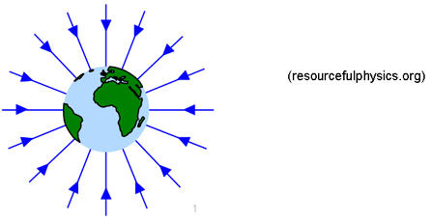
Field around a uniform spherical mass

Slide 31
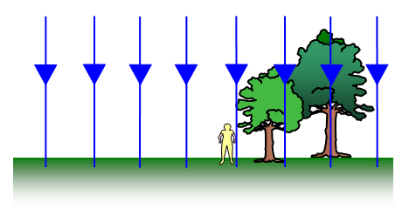
Field close to the earth’s surface
Uniform

Slide 32
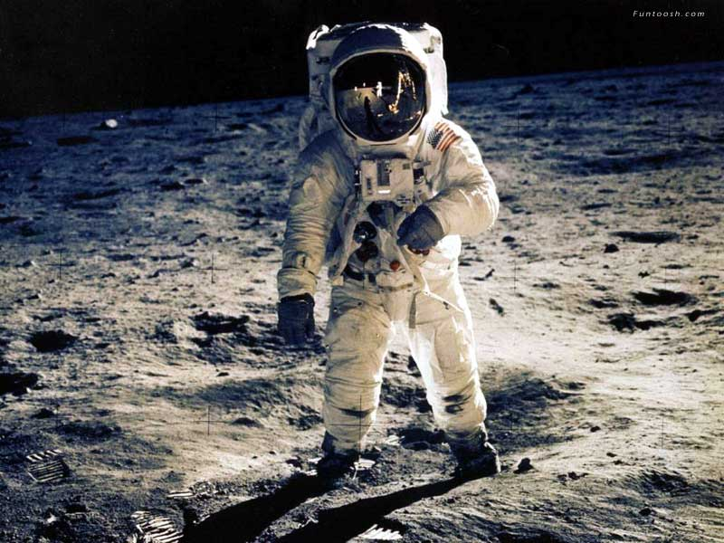
Now go try some of your text questions
on
Newton’s law of gravitation

